Slide 1

GACC
EST.2008
REGISTRATION SERVICE ORGANIZATION

Slide 2


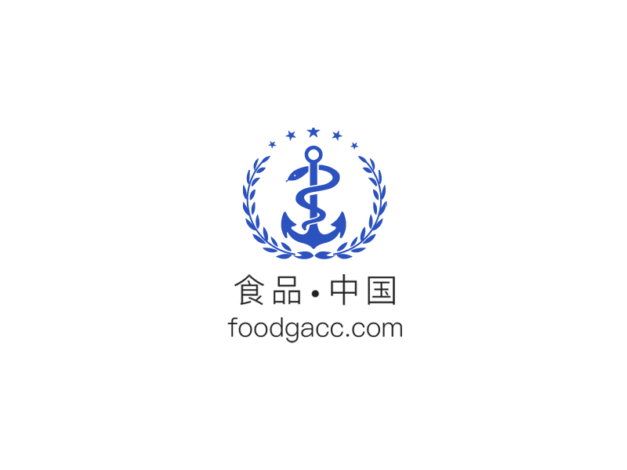
Company Introduction
Under statutory regulations, GACC Registration Service Organization is a specialized service organization established in 2008 in Beijing China.
We maintain good communication with testing laboratories at all levels, aiming to build a consulting bridge between overseas manufacturers and exporters of imported food and Chinese food regulatory agencies, eliminate redundant regulations and language barriers, and assist global imported food overseas manufacturers to complete China Customs (GACC) Access and Registration, exporter filing, food compliance technical services, training and translation services, interpretation of Chinese policies and
standards, GACC access Remedy, etc.

Slide 3



Company Introduction
Our expert team is composed of food-related professional doctors, masters,
and government working experience personnel.
Experienced and good at communication, we can accurately provide straight-through solutions, offer our customers with the concept of "compliance and value synchronization", avoid risks such as misjudgment, detention, return shipments, recalls, etc., and help customers achieve corporate access and product compliance, helping global companies
expand their target markets.
gacc@foodgacc.com
+86 135 2112 7919
https://www.foodgacc.com

Slide 4


Our Specialty
Professional Service
Many years of professional experience, familiar with Chinese customs access and product compliance laws and regulations, maintain close communication with overseas food safety regulatory agencies, and help customers achieve enterprise access and product compliance per official standards and procedures.
Quickly enter the Chinese market to enhance competitiveness.
Strong Team
We are a highly qualified professional team with rich experience, insisting on the service tenet of innovation, execution, competitiveness, and progressing. All relevant staff have obtained doctoral, master, and bachelor degrees, and have been engaged in food cooperation for many years. Most of the employees have overseas experience, and are familiar with the food legal system in China and abroad, communicate smoothly without language barriers, and can provide food
standard translation and access operation training.

Slide 5


Our Specialty
Global Vision
We have the vision of "becoming a global food compliance service provider", and provide technical support for government officials, industry associations, manufacturers, and exporters in various countries so that customers can meet the target market access conditions, eliminate technical trade barriers, and promote globalization. Food trade integration provides high-quality compliance technology solutions.
Strict Confidentiality
We only focus on food business access and product compliance services. We contribute great importance to the protection of your data and privacy. We strictly abide by the confidentiality agreement for sensitive information related to the production and trade of the company, and will not disclose information to anyone for any reason to the third party, and will not pose a potential threat to the
interests of the company.

Slide 6

Our Specialty
Add-on Services
Provide customers with continuous tracking of relevant regulations and policies and timely updates;
Provide enterprise information change service and reminders of the extension of the qualifications for approved enterprises;
Help companies communicate with importers and law enforcement agencies;
Assist in import food label review, customs clearance assistance, etc.

Slide 7




GACC entry, registration and compliance services
GACC Entry Permission Service
Under GACC Decree 249 before a specific category of food product can be exported to China, the exporting country/region food safety management system and sanitation system shall firstly pass GACC’s equivalence assessments and reviews. (GACC Decree 249, Ch.II,
Artcle 11-17)
With years of successful practical experience we provide professional services to assist exporting countries/regions to pass GACC’s equivalence assessments. Our service contents
and procedures include but not limited to:
Guide you step by step starting with contact your domestic C.A. ^{[1]} to apply for GACC’s entry inspection through the diplomatic channel;
Guide and assist your domestic C.A. ^{[1]} to complete GACC’s questionnaire;
Keep monitoring GACC’s review process and provide necessary assistance;
Guide and supplement till GACC approves and signs protocols with your domestic C.A. ^{[1]}
Guide and assist you to be added in the GACC list of “approved export countries/regions and products”
01
[1] ‘C.A.’ stands for ‘competent authority’

Slide 8

GACC entry, registration and compliance services
GACC Registration Service
In accordance with GACC Decree 248, Article 1-4 and GACC Decree 249, Article 18, all overseas manufacturer, processor and storage facilities of imported foods shall obtain
registration with GACC.
For more than a decade, our GACC Registration Service team has been dedicated to provide professional, efficient one-stop registration services to global food manufacturing
enterprises. Our Service contents and procedures include but not limited to:
Step-by-step assistance, guidance and services starting with categorizing your products and deciding the best registration approach for you;
Request, guide and assist your domestic C.A. ^{[1]} to create an account for you if needed;
Fill in the application information in the correct form;
Guide and assist you to prepare for registration materials before submitting to GACC or your C.A. ^{[1]} for their inspections;
02
[1] ‘C.A.’ stands for ‘competent authority’

Slide 9

GACC entry, registration and compliance services
GACC Registration Service
Guide and assist your C.A.^{[1]} to conduct review reports on your production sites and prepare for other registration materials if needed;
Keep monitoring GACC’s review process and submit supplement materials if needed;
Guide and assist you to pass GACC’s on-site inspections or video inspections if needed;
After the application is approved, we will inform you of the registration number;
Our services does not stop by getting the registration number. We aim to provide continuous, integrated services to help clients maintain registration, compliance qualifications and Chinese market competitiveness all through the 5-10 years service period. Our post-
registration services include:
    Managing and securing your registration accounts;
    Providing consulting services and training courses to help you better understand Chinese food safety requirements;
    Analyzing potential trade risks, etc.
02
[1] ‘C.A.’ stands for ‘competent authority’

Slide 10
GACC entry, registration and compliance services
GACC Compliance Services
Chinese imported food safety administration system is a sophisticated system, composing of more than a hundred laws, regulations and standards, with several functional departments
who formulates and implements them.
Relevant laws are legislated by National People’s Congress; GACC, NMPA, SAMR and National Health Committee establish a cooperative effort to implement the laws and supervise imported food safety; several departments and associations also contributes to the overall
food safety management, including CFSA, CCA, testing laboratories at all levels, etc.
With years of compliance experience and professional knowledge, our team is proficient throughout all these laws, regulations, standards and competent departments. We are capable to evaluate if our client’s products are compliant with these requirements and provide applicable compliance solutions, helping you to establish a firm foundation and qualification of
operating in Chinese imported food market.
03

Slide 11
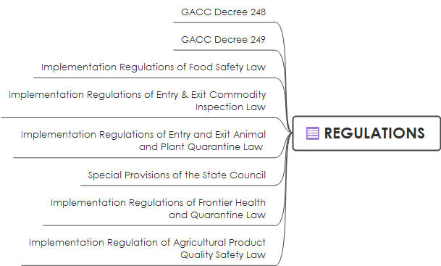
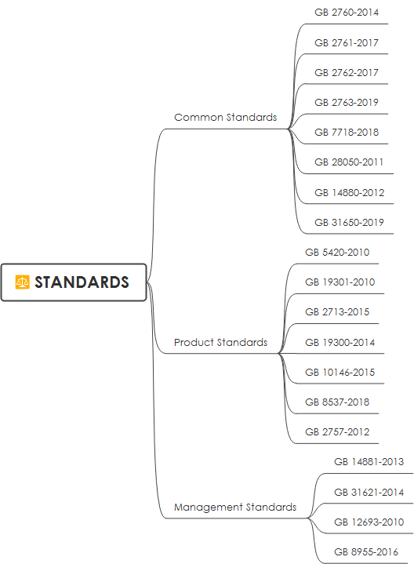
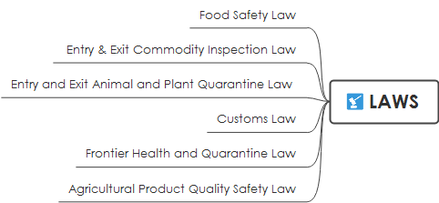
GACC entry, registration and compliance services
GACC Compliance Services
03
Compliance analyze based on these relevant laws, regulations and food safety standards

Slide 12


GACC entry, registration and compliance services
GACC Remedy Services
Our institution provides remedy services for overseas manufacturers in different entry failure situations. Our professional team will analyze the cause of entry failure and provide accurate remedy solutions to assist you obtain entry qualifications successfully. We provide remedy
services under these situations, include but not limited to:
Remedy for domestic competent authority review failure
Remedy for information correction issued by domestic competent authority
Remedy for GACC inspections failure
Attorney Remedy
Other remedies
Note: The Remedy measures here is a kind of self-definition of certain business types by our institution, it does not represent official expressions, and are not related to any other third parties and traditional trade remedies. Technical barriers, self-deficiencies and confirmation
of registration requirements do not belong to the category of Remedy.
04

Slide 13
GACC entry, registration and compliance services
Training Services
Training is the most direct and effective way for companies to understand the target market. To quickly understand the access procedures about overseas manufacturers, exporter filing procedures, national food safety standards, product compliance programs, trade supervision conditions, official supervision systems and regulatory frameworks, etc. we prepare relevant courses and training by way of online courses and webinars.
The training content includes:
1. Categorize products to determine the registration methods and application materials for overseas manufacturers, processors, and storage facilities;
2. Laws, regulations and compliance paths for product technical compliance and label compliance;
3. Countermeasures to trade procedures and regulatory conditions;
4. Overall study of China's regulatory system, regulatory framework and food standards;
5. According to the actual situation of the enterprise, provide one-stop enterprise access solution path analysis;
6. According to the actual situation of the product, provide one-stop product compliance solution path analysis;
7. Other access and compliance information;
05

Slide 14
GACC entry, registration and compliance services
Translation Services
Our translation center is a technical support department under our Compliance Department, which is mainly engaged in the mutual translation of standards, policies, food, additives, new food raw materials, food contact materials, pesticide residues, veterinary drug residues, pollutant limits, chemistry, agriculture and related fields work to enable market entities engaged in food trade with China to obtain accurate and effective regulatory information.
Professional Translation: The team consists of masters and doctoral talents in foreign languages, food, chemistry, agriculture and other majors, and mutual translation and mutual proofreading ensure the quality of translation.
Accurate translation: Professional talents ensure the accuracy and professionalism of the translation. Special nouns and special terms are supplemented with professional expressions to prevent out-of-context and unclear translations.
Strict Process: Strictly follow the procedures of "receiving" → "initial translation" → "proofreading" → "professional review" → "finalization" → "handover" → "customer feedback" → "post-translation follow-up". Among them, the four steps of "initial translation"→"proofreading"→"professional review"→"finalization" are completed by translators of different professions, and strict quality control is implemented in each step to ensure accuracy.
06

Slide 15
Service Procedures
To understand the content and attributes of the project entrusted by the customer, our company classify and analyze the project, and conduct the project feasibility report and implementation plan, and
deliver to the customer
Project Negotiation
Signing
Contract
Payment
Continuously
Services
Completing
Project
Implementing
Project
Comprehensive entry compliance and trading support services, keeping you updated with Chinese trade dynamics and food safety situations continuously
Our company will set up a project team to fully implement the service plan, and the customer will provide the required materials
and information

Slide 16
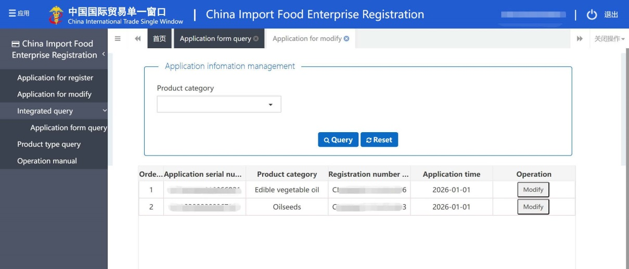

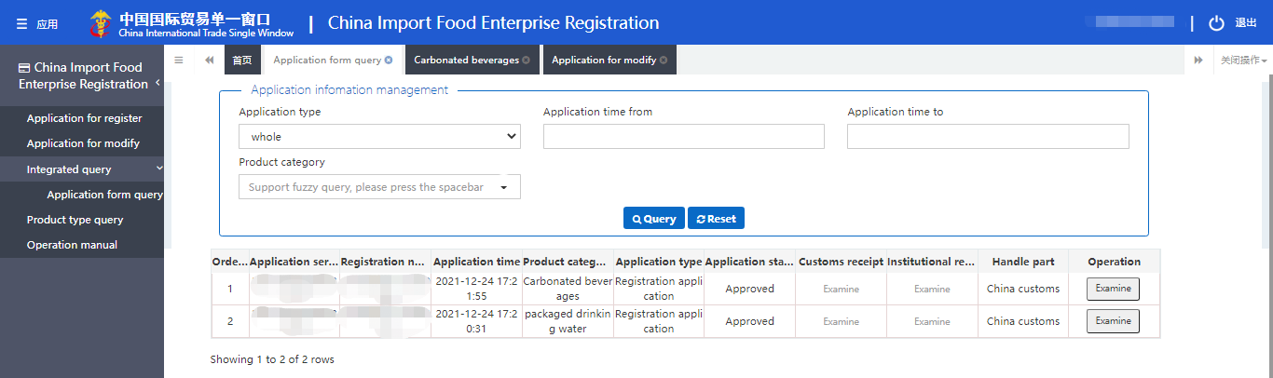
Successful Registration Cases
C.A.
RECOMMENDATION
SELF
REGISTRATION

Slide 17





CONTACT
WhatsApp
WeChat
registry@foodgacc.com
+86 189 1124 4880
www.foodgacc.com

